Slide 1
College bound Student-Athletes
Preparing Middle & high school students
for college athletics
Barbara Truluck, M.Ed., NCC, NCSC

Slide 2
Which option is the best fit for your students?

Slide 3
NCAA
National collegiate athletic association

Slide 4
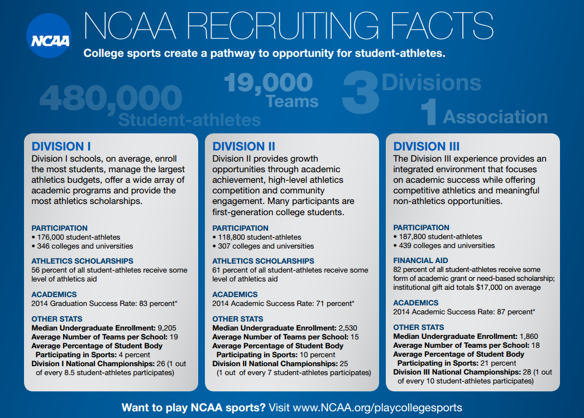

Slide 5
Ncaa sports

Slide 6
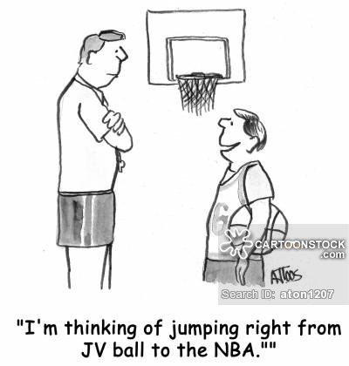
DO YOUR STUDENTS TALK ABOUT GOING PRO?

Slide 7
THE CHANCES OF YOUR STUDENTS GOING PRO

Slide 8
Initial eligibility High school student process
GRADE 9 - PLAN
GRADE 10 - REGISTER
Start planning: Take the right courses and earn good grades
Discuss NCAA approved core courses with HS counselor
Sign up for a free profile page to receive NCAA reminders
Register with the Eligibility Center
Continue to have conversations with HS counselor to make sure they are on the right path

Slide 9
Initial eligibility High school student process
GRADE 11 - STUDY
GRADE 12 - GRADUATE
Work with counselor to keep on track and are able to graduate with class
Take the ACT or SAT and submit to the NCAA – code 9999
Counselor should send or upload transcript at end of year
Complete final core courses
Take SAT or ACT again, if needed
Request final amateurism (April 1)
Counselor should send or upload transcript after graduation

Slide 10
Division I academic standards

Slide 11
Division II & III academic standards
NOTE: Both Division I and Division II (effective August 2018) use a sliding scale that compares the core course GPA to the SAT and/or ACT Sum score. Based on the comparison of these two criteria a Final Qualifier, Academic Redshirt (DI), Partial Qualifier (DII), or Nonqualifier status is determined.

Slide 12
SAT/ACT Sliding Scale

Slide 13
How to help your students register
Choose from 2 account types:
Certification Account (DI and DII)
Profile Page (DIII)
Valid Student Email
Used for communication and updates from the NCAA
Must use a different email than a sibling who has previously registered
Basic Student Personal Information
Basic Student Education History
All high schools attended, including international Student Sports Participation History
Student Sports Participation History
List all sports they plan to participate in at an NCAA school (i.e. XC, Indoor/Outdoor Track)
Includes information regarding individuals who have marketed their skill (i.e. agent/scouting service)
Payment
$80 (International students is $135)
Profile page is free
Fee Waiver (if the student received a waiver of the SAT or ACT fee)
www.eligibilitycenter.org

Slide 14
Who’s responsibility is it?
Who determines who should and should not register with the NCAA Eligibility Center?
Coaches should provide realistic advise on the likelihood of the student-athlete playing a NCAA sport
The student’s family should make the final decision
How does a student become eligible upon graduation?
NCAA Eligibility Center
Academic achievement in high school, starting in Grade 9 – Eligibility is a four-year process

Slide 15
Who’s responsibility is it?
How are students noticed or recruited
for college sports?
Coaches should advise and assist during the recruiting process to determine the best fit for the student-athlete.
The student’s family should contact colleges they are interested in.
Who helps the student and their family understand recruiting rules?
The NCAA schools that are recruiting the student should ensure the recruiting rules are followed. Rules differ by sport and division.

Slide 16
Practical recruiting advice for your students
Start Early and Research School Websites
Visit Schools – Official and Unofficial Visits
Honest Communication with College Coach as to Level of Interest
Personalize Communication with College Coaches
Attend Showcases and Sports Camps (ID/Prospect Clinics)
Proofread all Correspondence
Work with high school coaches before submitting information
Should NOT Discuss Money in First Communications
Be Careful of Postings on Social Media
College coaches take notice
Be Respectful to HS Coaches and Parents
College coaches watch student interactions

Slide 17
Odds of earning an athletic scholarship
There are approximately 480,000 NCAA student-athletes between all three divisions compared to 7,800,000 high school student-athletes.
Of the 480,000 student-athletes, only 150,000 are on an athletic scholarship = 31.25%.
There are many other opportunities to receive aid outside of an athletic scholarship.
Division III schools have the most financial aid opportunities to offer students.

Slide 18
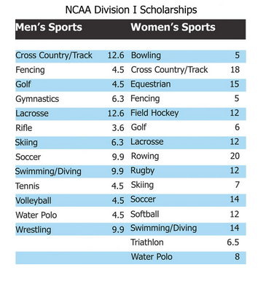
Division I athletic scholarships
Football, M/W Basketball, and W Volleyball are only allowed to offer full scholarships.
All other sports can divide their allotted scholarships by whatever amount, or percentage, the coach desires.
Baseball is not allowed to give athletic scholarships below 25%.

Slide 19
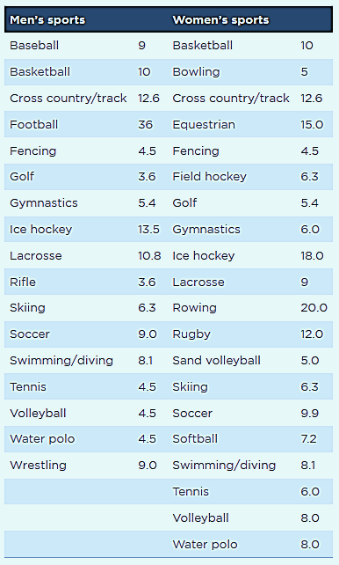
Division ii athletic scholarships
Partial Scholarship Model
(“equivalency” model)
All sports can divide their awards by the team limits allocated by the NCAA

Slide 20
Odds of earning an athletic scholarship
* There are more Division II Scholarships
available than Division I *
* There’s a higher chance of an athlete receiving an athletic scholarship at the Division II level due to how they can divide up their scholarships *

Slide 21
Points to remember
Have your students register with the NCAA Eligibility Center and take the right core courses for eligibility
Make sure new courses and programs are updated with the NCAA
Discuss the multiple college options with your students to find the right fit for them
Encourage your athletes to review the Guide for the College-Bound Student-Athlete
Be realistic with your athletes on opportunities available.

Slide 22
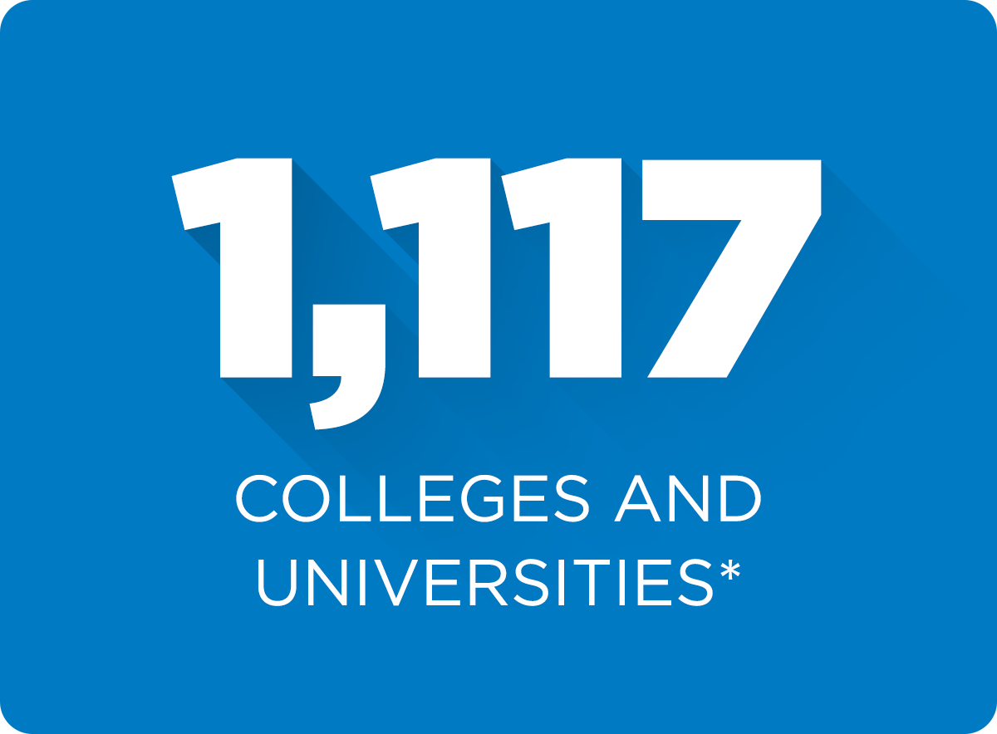
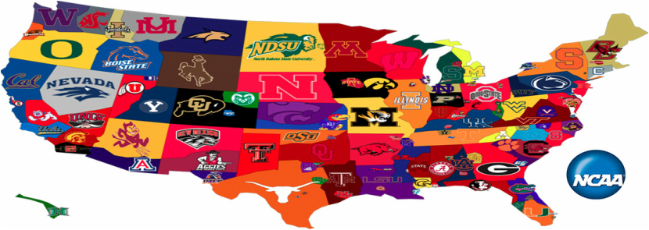
QUESTIONS ???

